Slide 1

Mortgage Application AI
AI to extract all fields necessary for form 1003 from a loan application call/transcript

Slide 2
Problem STATEMENT
With the rise of conversational AI and natural language processing (NLP), there is an opportunity to automate the extraction of relevant data directly from customer call transcripts. However, achieving accurate extraction from unstructured conversational text poses challenges such as:
Identifying specific fields within free-form dialogue
Handling ambiguous, incomplete, or corrected information
Providing confidence scores to indicate data reliability
Managing variability in phrasing, slang, or informal speech
The core problem addressed by this project is the need for an intelligent system that can:
Ingest a transcript of a mortgage-related customer service call
Accurately extract predefined fields (e.g., Borrower Name, Loan Amount, Employer Name, Social Security Number, etc.)
Assign a confidence score to each extracted value to reflect extraction certainty
Return this data in a structured JSON format compatible with backend systems
Provide a user-friendly interface for users to input transcripts and view results
This system aims to eliminate manual data entry, reduce processing time, improve data accuracy, and enhance overall efficiency in mortgage application processing by leveraging generative AI models for real-time information extraction.

Slide 3
SYSTEM ARCHITECTURE / APPROACH
This system is an AI-powered solution for automatically extracting structured data from customer-agent call transcripts to populate a mortgage loan application (Form 1003). It includes:
A FastAPI backend exposing a /extract-fields REST API.
A Gradio-based frontend for interactive testing
Integration with a locally hosted Mistral LLM using Ollama
A prompt-engineering approach to instruct the model to return valid JSON with field names, values, and confidence scores
JSON parsing and validation before presenting results.
Key Features:
Extracts around 23 predefined mortgage application fields
Returns JSON with field_name, field_value, confidence_score
Uses Ollama running Mistral LLM locally (no OpenAI or Gemini dependency)
Validates AI response for JSON format compliance
Supports both API access and UI interaction via Gradio
Designed to handle ambiguous, incomplete, or corrected responses
Enforces confidence scoring based on certainty of extraction
Technical Components:
Gradio UI → allows user to input transcript and view extracted fields
FastAPI Backend → handles prompt construction, API routing, JSON parsing
Ollama Mistral Model (local) → processes prompt and generates extraction in JSON
JSON Validation → ensures valid and clean JSON output
REST API Endpoint → /extract-fields allows integration with external clients

Slide 4
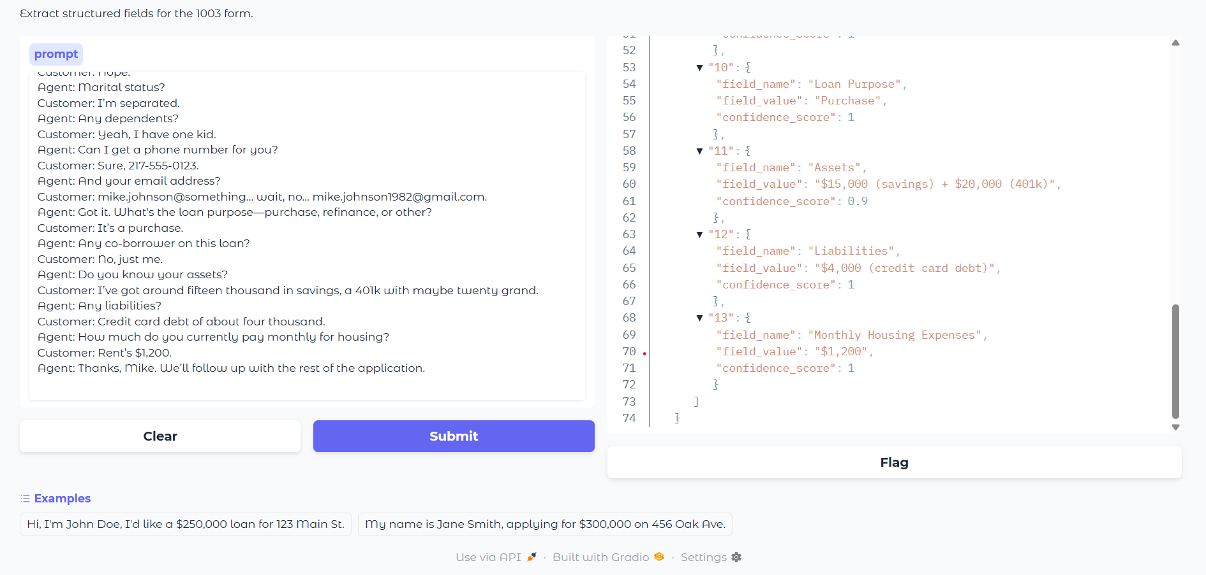
User Input Via Gradio
Post request to/extract-fields
Prompt Generation. (User input appended to existing prompt)
API call to Ollama Mistral model running locally
Output Displayed on Gradio UI
FastAPI backend Json parsing and validation
Json extraction as per logic from transcript via model

Slide 5

Technical Approach
Built using FastAPI to expose a REST API endpoint /extract-fields
Used Gradio to build a simple, user-friendly web UI for input and result display
Integrated with a locally hosted Mistral LLM via Ollama API (no external API like OpenAI/Gemini)
Designed a prompt-engineering strategy embedding extraction instructions and JSON formatting rules into the input prompt
Implemented dynamic prompt construction: user transcript is embedded into the prompt template
Communicated with Ollama API via HTTP POST requests from backend
Validated AI-generated response by parsing JSON and handling invalid outputs
Implemented error handling for invalid input, model errors, and JSON decoding issues
Returned structured JSON containing field_name, field_value, confidence_score for each extracted field
Supported both interactive UI input and programmatic REST API calls

Slide 6
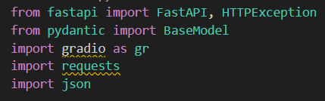
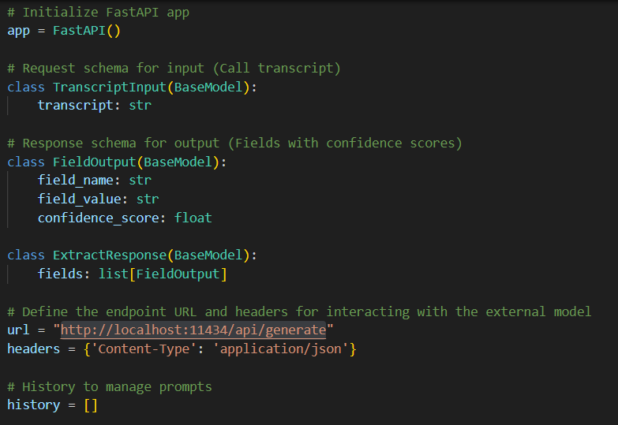
Code walkthrough
- Import the necessary modules
- Initialize Fast API to use it later to create API.
Define a class named TranscriptInput which has one parameter called BaseModel. BaseModel is the core class in Pydantic that we inherit from to create data models with automatic data validation, type checking, and parsing of Input data. We use this class to create object of Input in our API.
Similarly create class for output.
Next, we create the ExtractResponse class which is our main class that we use to Extract response from the model based on prompt which is created here.
In this class, first we define our Model endpoint url which we use to get our response from mistral model.
We also define our prompt in this class.

Slide 7
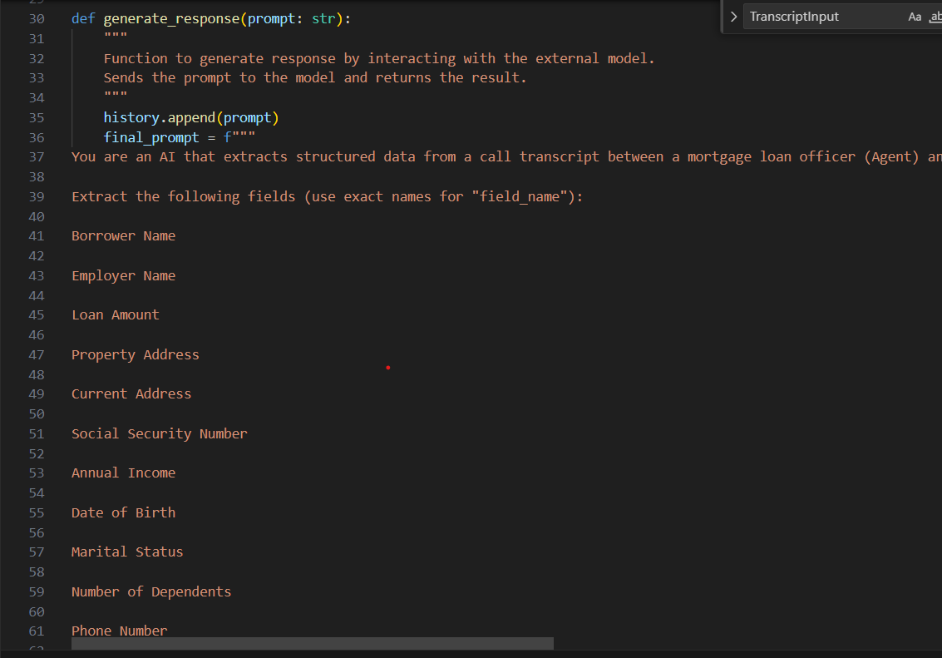
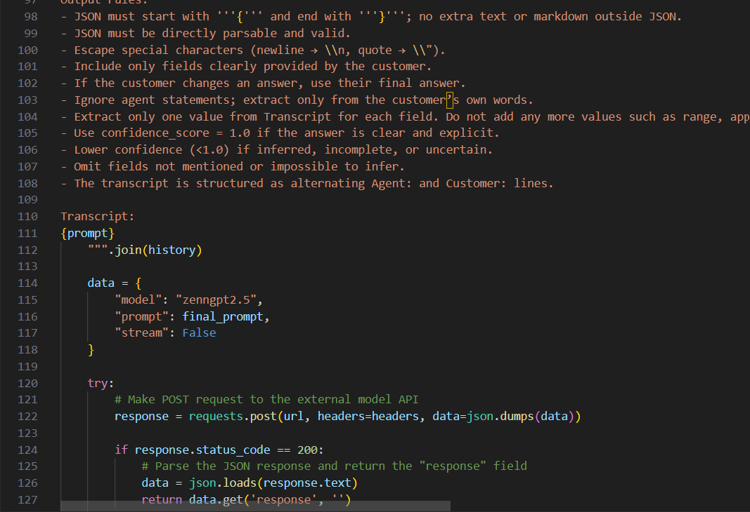
Next, we define the most important function which is our generate response function. This function is called from the API function and in the parameter here we pass the query/transcript that the user has entered. Based on that we create our final prompt here and then make a call to out local llm url using HTTP post request.
In the post request, we pass the url, headers and also pass a field called data which defines which model to use and what prompt should be used. So, we say that use Zengpt2.5 and use the final prompt that was created above.
Thus, we pass whatever response we get from model to the API function

Slide 8
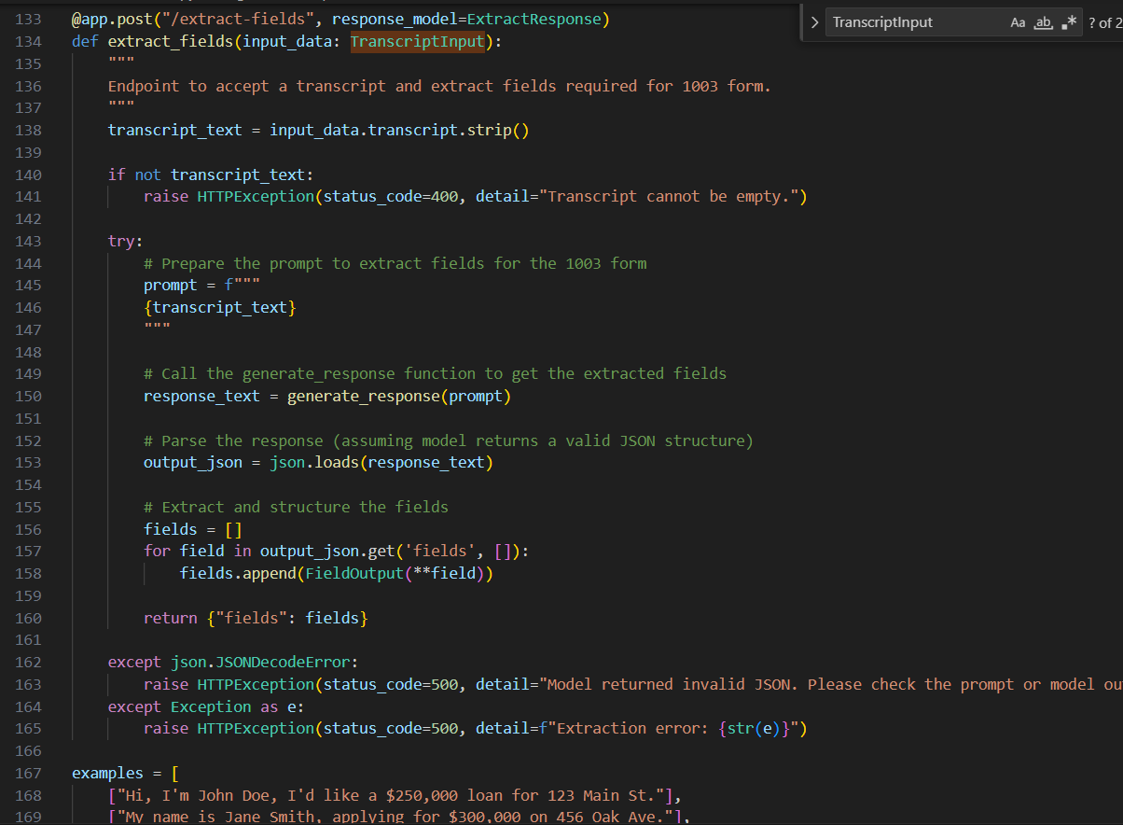
Here we have our API code. First, we define that the type of API is post. After that we strip the input prompt and see if it is not empty. We throw error if the input is empty.
Moving on, once we have validated the input, we then call the generate response function. We convert the output of this function to a valid json and finally check if it got converted. If it is not a valid json we again throw error.

Slide 9
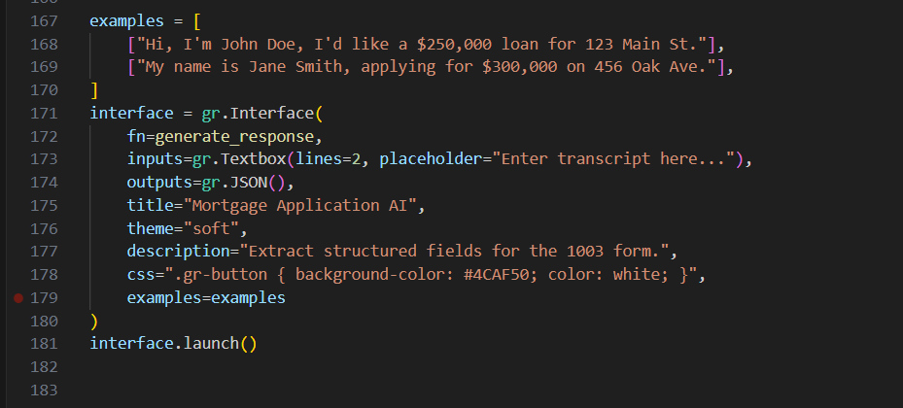
Finally we have our gradio code for the UI. We define the input and output types (Text/Json, etc). Gradio will accordingly set up blocks on UI.
We also add some extra fields such as Title, Theme, Description and examples.
Finally we add some CSS elements to give it a more AI type of look like the other AIs such chatgpt and gemini.

Slide 10
Challenges
There is no free version of OpenAI available so I tried using the free version of Gemini AI for this project but for some reason that didn’t work out. I also tried an open-source API key by ‘pawan0sman’ on GitHub that replaces the API key needed to use OpenAI API with a proxy one. But for some reason even that didn’t work out (probably an update in OpenAI’s policy blocked this repo from using their resources for free). I spend a lot of time into thinking what can I do such that I don’t end up spending and be able to use LLM models?
That is when I decided to go ahead with ‘OLLAMA’. Ollama is a tool that allows you to run large language models like Mistral, Llama, and others locally on your own machine through a simple API interface. The only problem here was that we had to compromise on the processing time, but the output was still accurate.
So now I had Ollama set up, I was using the mistral Model, I trained this model using a ModelFile with the prompt I wanted my model to understand. I was accessing this model locally on my system using HTTP request to ‘http://localhost:11434/api/generate’.
As the processing time was almost around 700-800 seconds for a conversational prompt (Large prompt). I created 2 prompts – 1. To test the model when there is a conversation between the Agent and the Customer (Small prompt = Lesser execution time). 2. Just to try the edge cases when just customer is speaking, and we just have one statement from which we look to extract all our info.

Slide 11
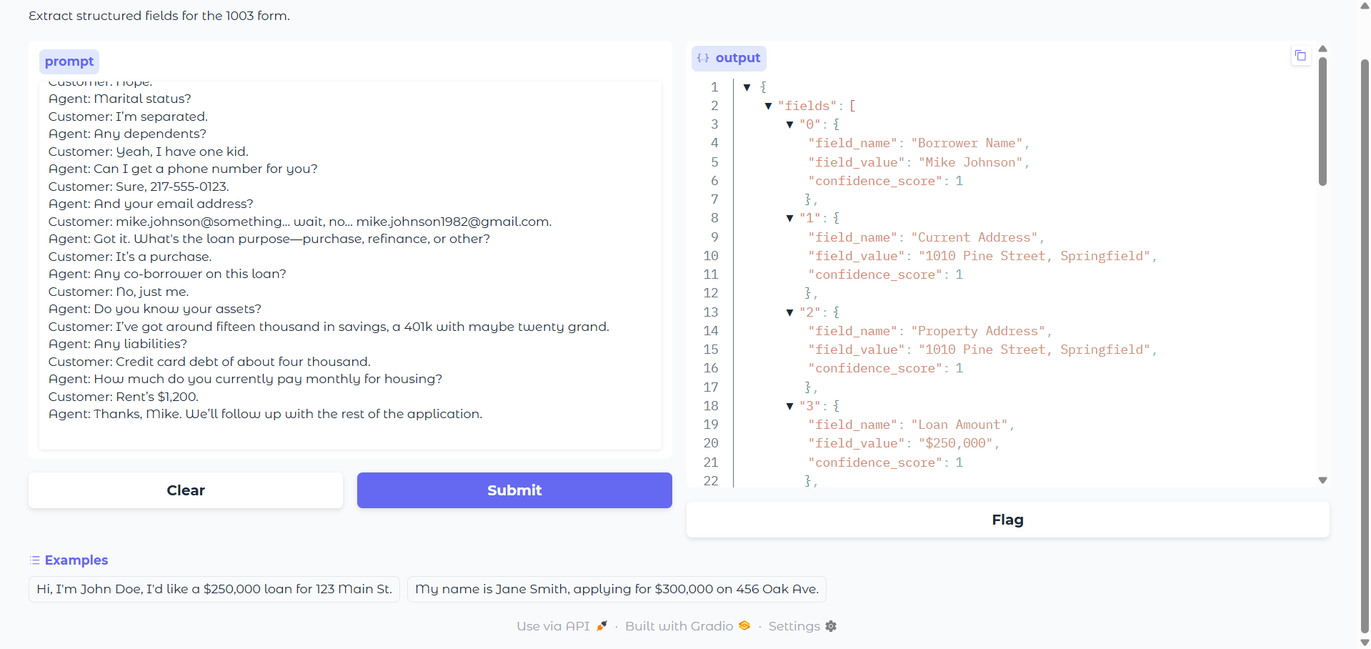
Demos
As mentioned earlier, that the processing of the actual telephonic transcripts was taking more than 700-800 seconds, I have texted this including all the edge cases such as missing info, confusing input, etc., all in one statement.

Slide 12
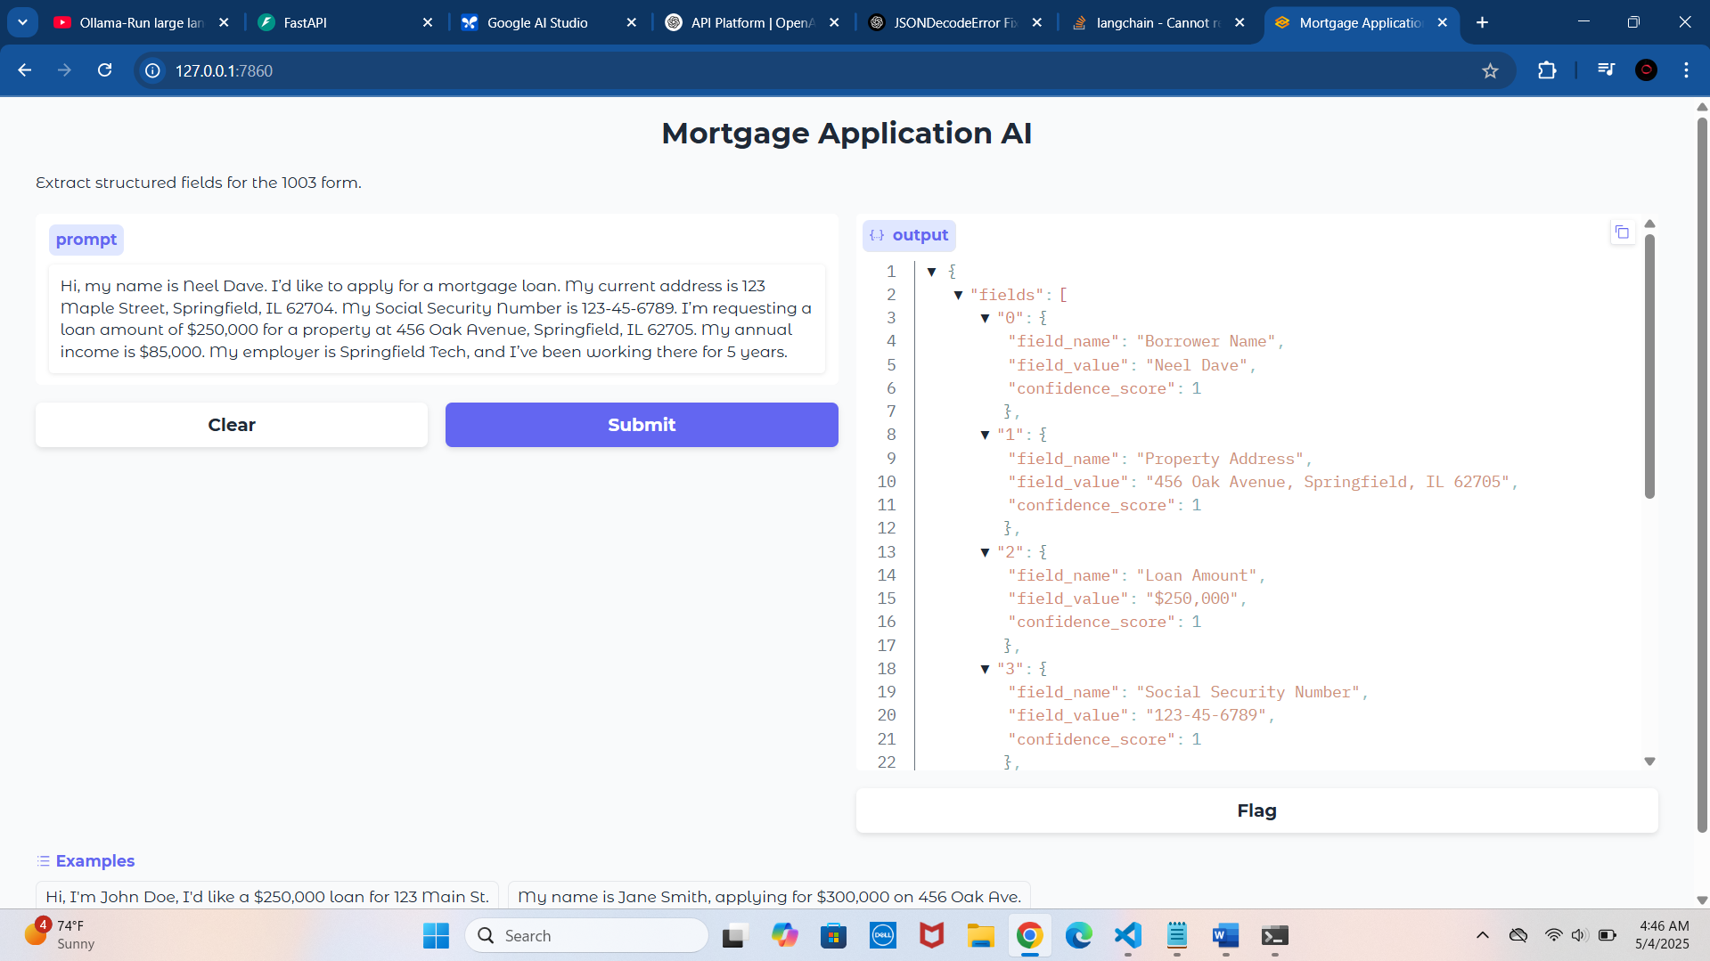
Demos
Complete, clear positive case
Hi, my name is John Doe. I’d like to apply for a mortgage loan. My current address is 123 Maple Street, Springfield, IL 62704. My Social Security Number is 123-45-6789. I’m requesting a loan amount of $250,000 for a property at 456 Oak Avenue, Springfield, IL 62705. My annual income is $85,000. My employer is Springfield Tech, and I’ve been working there for 5 years.

Slide 13
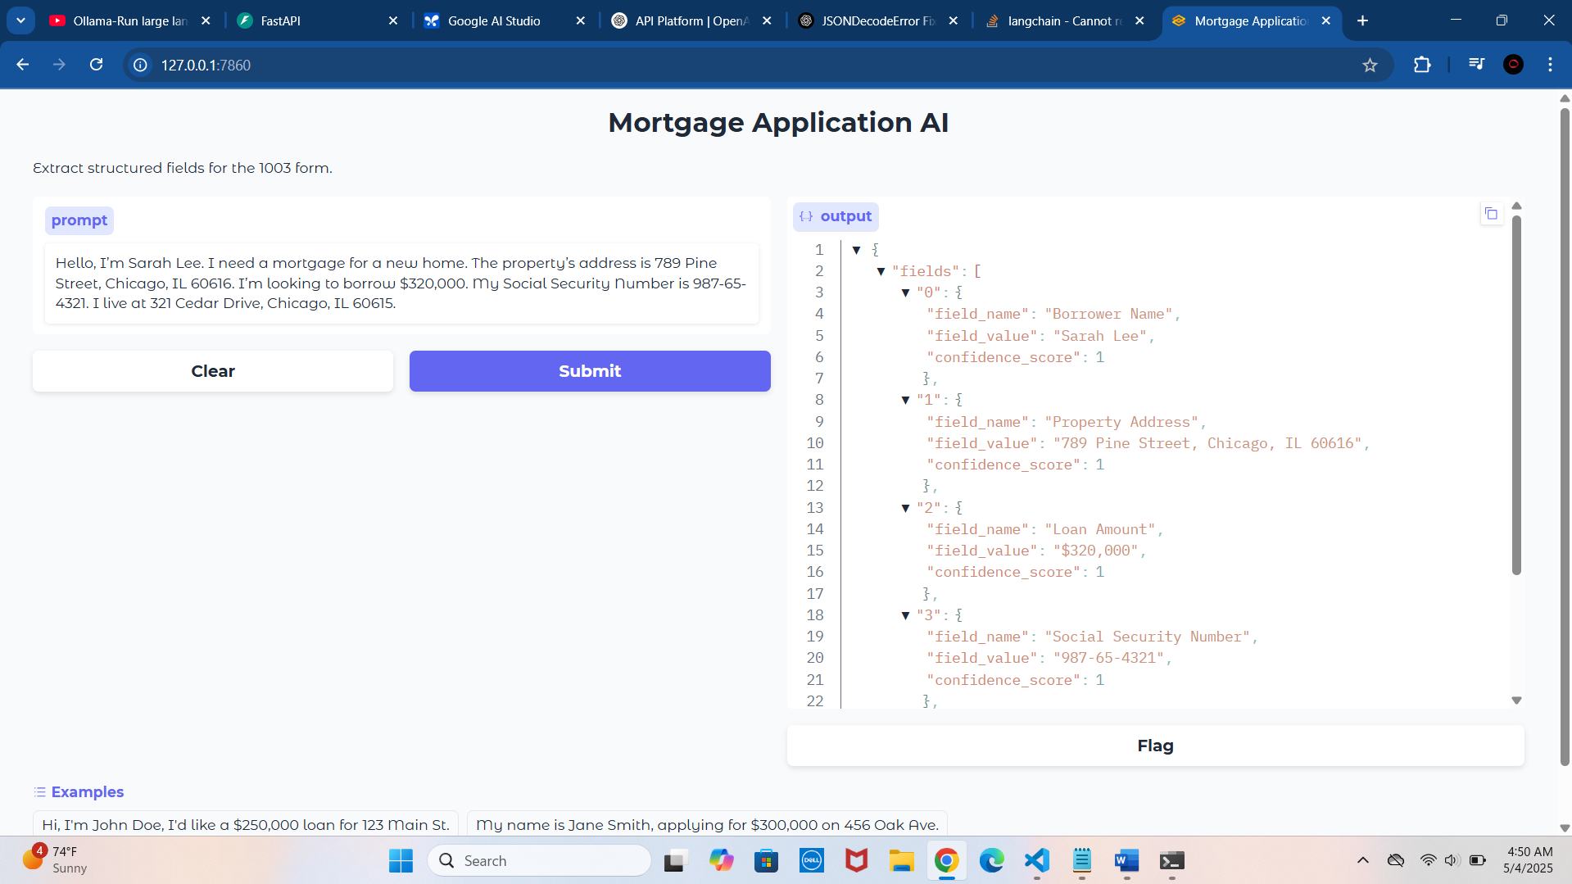
2. Missing one key field (income)
Hello, I’m Sarah Lee. I need a mortgage for a new home. The property’s address is 789 Pine Street, Chicago, IL 60616. I’m looking to borrow $320,000. My Social Security Number is 987-65-4321. I live at 321 Cedar Drive, Chicago, IL 60615.

Slide 14
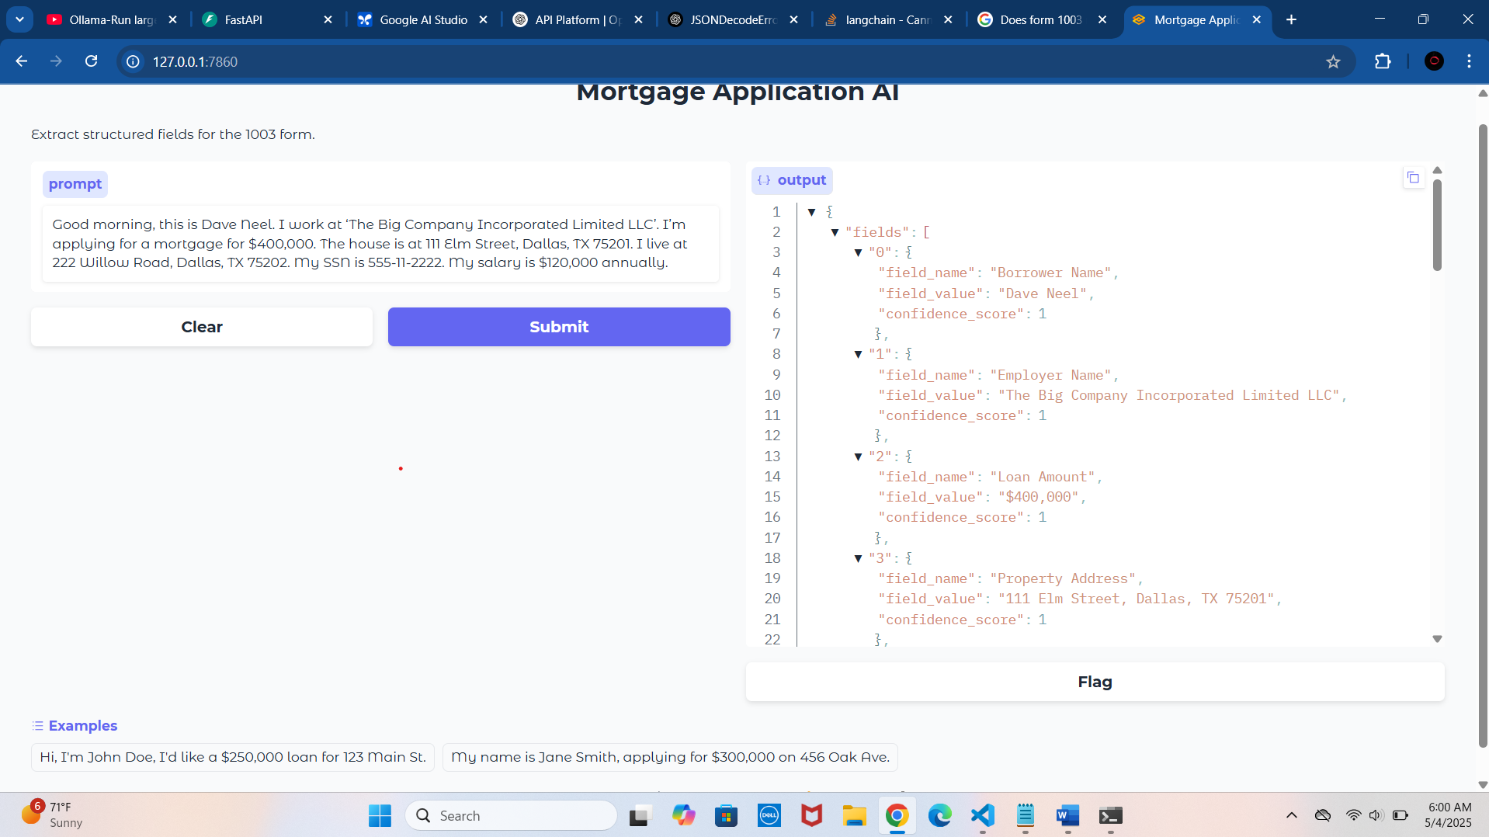
3. Ambiguous employer name (hard to extract)
Good morning, this is Dave Neel. I work at ‘The Big Company Incorporated Limited LLC’. I’m applying for a mortgage for $400,000. The house is at 111 Elm Street, Dallas, TX 75201. I live at 222 Willow Road, Dallas, TX 75202. My SSN is 555-11-2222. My salary is $120,000 annually.

Slide 15
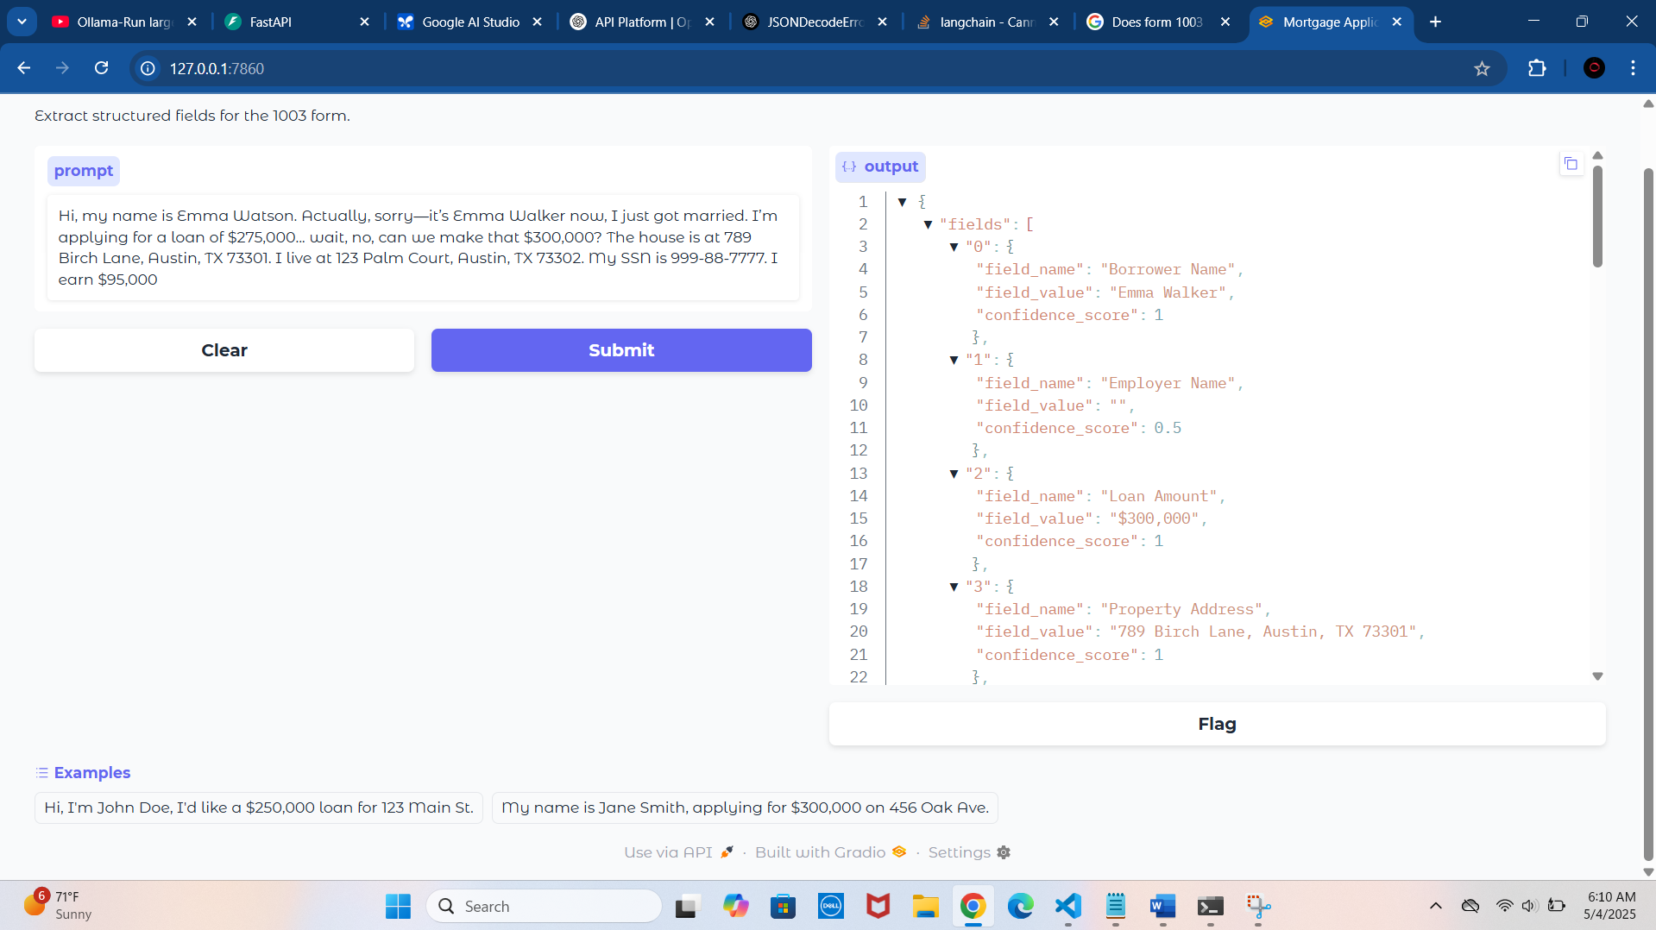
4. Customer changes mind mid-call (confusing input)
Hi, my name is Emma Watson Actually, sorry—it’s Emma Walker now, I just got married. I’m applying for a loan of $275,000... wait, no, can we make that $300,000? The house is at 789 Birch Lane, Austin, TX 73301. I live at 123 Palm Court, Austin, TX 73302. My SSN is 999-88-7777. I earn $95,000

Slide 16
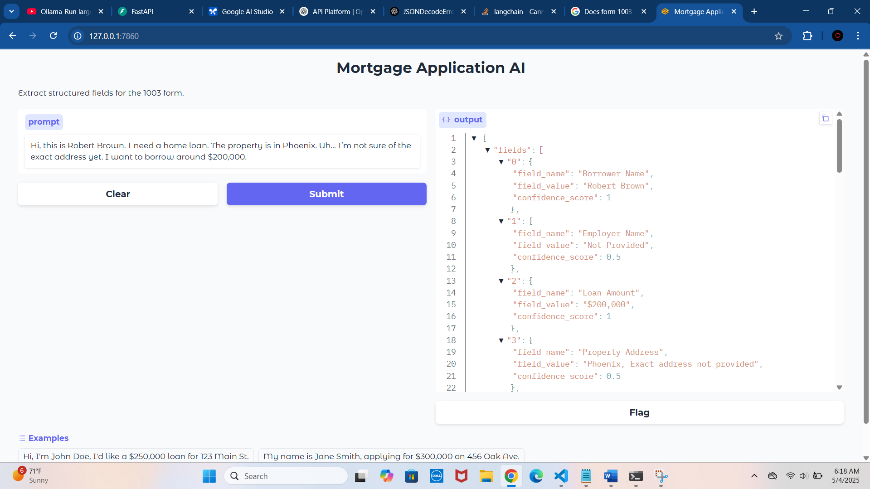
5. Provides partial information only
Hi, this is Robert Brown. I need a home loan. The property is in Phoenix. Uh… I’m not sure of the exact address yet. I want to borrow around $200,000.

Slide 17
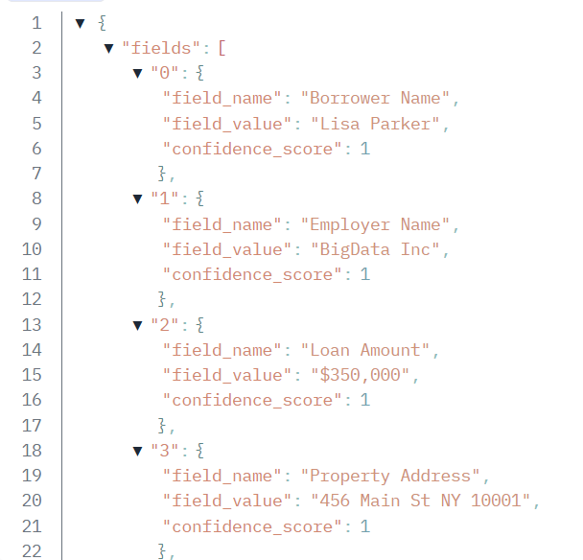
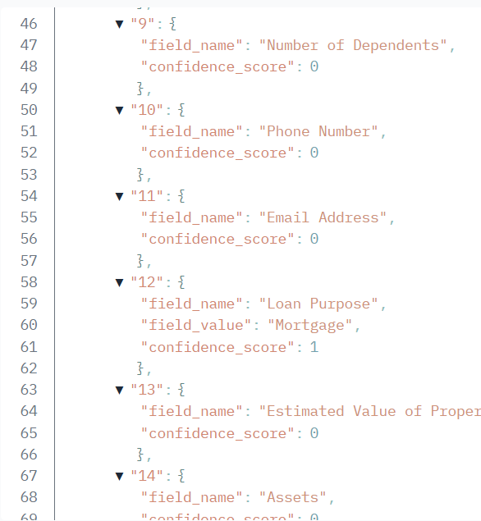

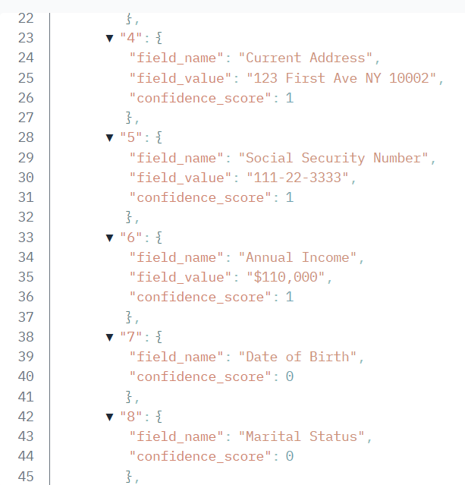
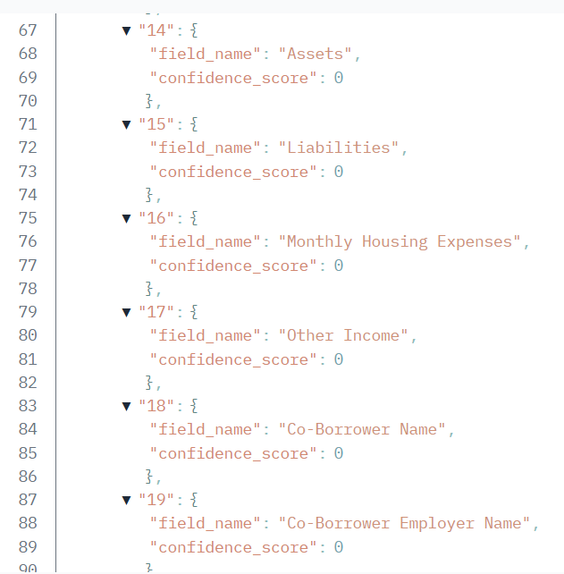
Speaks quickly and jumbled data
Yeah hi it’s Lisa Parker I need a loan for $350k for 456 Main St NY 10001 I live 123 First Ave NY 10002 SSN 111223333 make $110000 employer BigData Inc 3 years thanks.

Slide 18
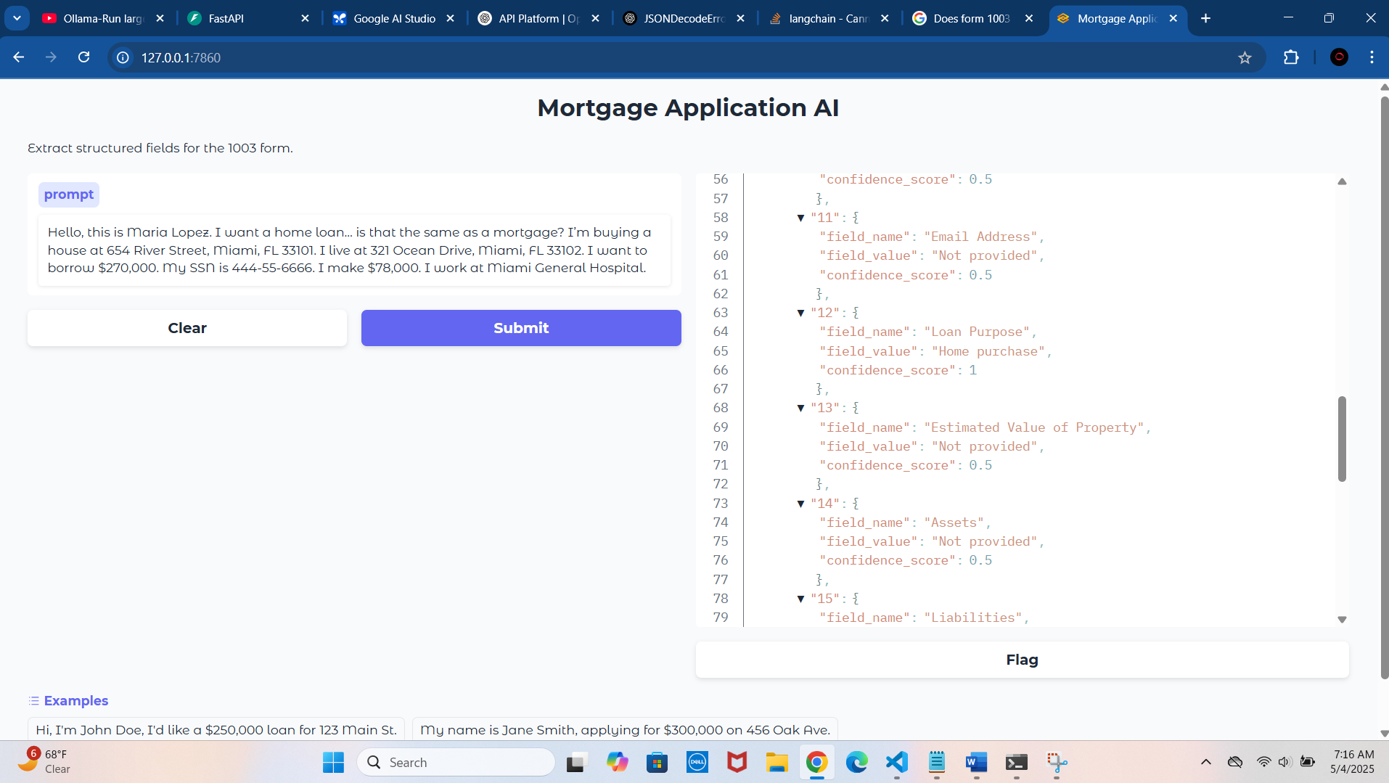
7.
Hello, this is Maria Lopez. I want a home loan… is that the same as a mortgage? I’m buying a house at 654 River Street, Miami, FL 33101. I live at 321 Ocean Drive, Miami, FL 33102. I want to borrow $270,000. My SSN is 444-55-6666. I make $78,000. I work at Miami General Hospital.

Slide 19
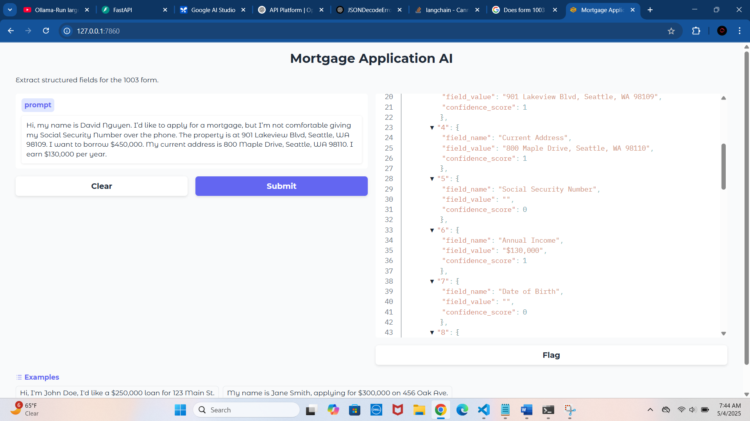
8. Refuses to give SSN on call (privacy concern)
Hi, my name is David Nguyen. I’d like to apply for a mortgage, but I’m not comfortable giving my Social Security Number over the phone. The property is at 901 Lakeview Blvd, Seattle, WA 98109 want to borrow $450,000. My current address is 800 Maple Drive, Seattle, WA 98110. I earn $130,000 per year.

Slide 20
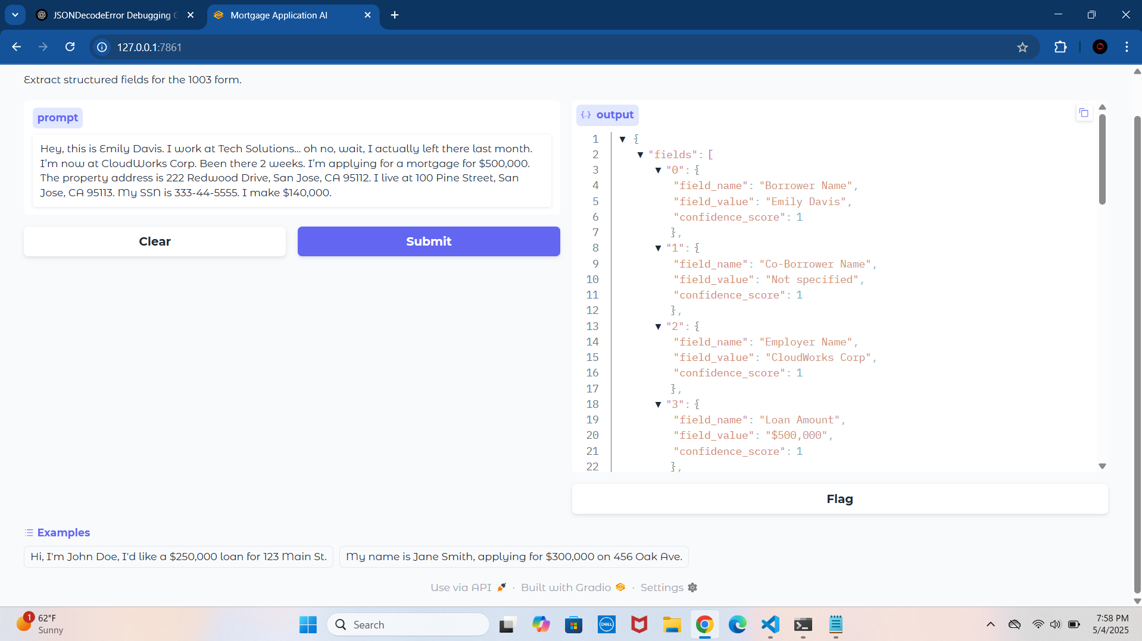
9. Provides old employer + new employer (contradictory info)
Hey, this is Emily Davis. I work at Tech Solutions… oh no, wait, I actually left there last month. I’m now at CloudWorks Corp. Been there 2 weeks. I’m applying for a mortgage for $500,000. The property address is 222 Redwood Drive, San Jose, CA 95112. I live at 100 Pine Street, San Jose, CA 95113. My SSN is 333-44-5555. I make $140,000.

Slide 21

IMPROVEMETNS AND FUTURE WORKS
Optimize inference speed by switching to a smaller or quantized model in Ollama (e.g., Mistral 7B Q4_K_M) to reduce latency
Explore using Mixtral 8x7B for better accuracy while balancing performance
Investigate running Ollama with GPU acceleration (if hardware available) to improve response time
Add asynchronous processing and task queue (e.g., Celery) to handle multiple requests without blocking
Implement caching for repeated prompts to avoid redundant model calls
Explore integrating a speech-to-text pipeline to process audio calls directly instead of manual transcripts
Improve prompt engineering to reduce model output errors and lower post-processing needs
Enhance error handling for edge cases and malformed model outputs
Deploy the model as a microservice with load balancing for scalability
Consider fine-tuning a smaller model specifically on mortgage call data for faster, more accurate extractions

Slide 22
Conclusion
This project has been a rewarding opportunity to apply my existing skills in AI integration, API development, and prompt engineering while tackling the challenge of extracting structured data from mortgage application call transcripts.
By combining FastAPI, Gradio, and a locally hosted Mistral model using Ollama, I successfully designed and implemented an end-to-end solution that transforms unstructured dialogue into a structured JSON format required for Form 1003, complete with confidence scoring and error handling.
Throughout this process, I refined my expertise in prompt engineering to control large language model outputs, learned to handle JSON parsing and validation challenges, and addressed real-world issues like model latency and edge cases in natural conversation.
I thoroughly enjoyed working on this project, as it allowed me to not only deepen my technical knowledge but also apply it to a meaningful use case with practical applications in the mortgage industry.
While the system achieves its core goals, I’m enthusiastic about continuing to improve its performance, scalability, and accuracy in the future—whether through optimizing model selection, implementing GPU acceleration, or enhancing the user interface and features.
This project reflects my commitment to continuous improvement, innovation, and a passion for building AI-powered solutions that bridge the gap between unstructured human input and structured data processing.

Slide 23
THANK YOU

